Slide 1
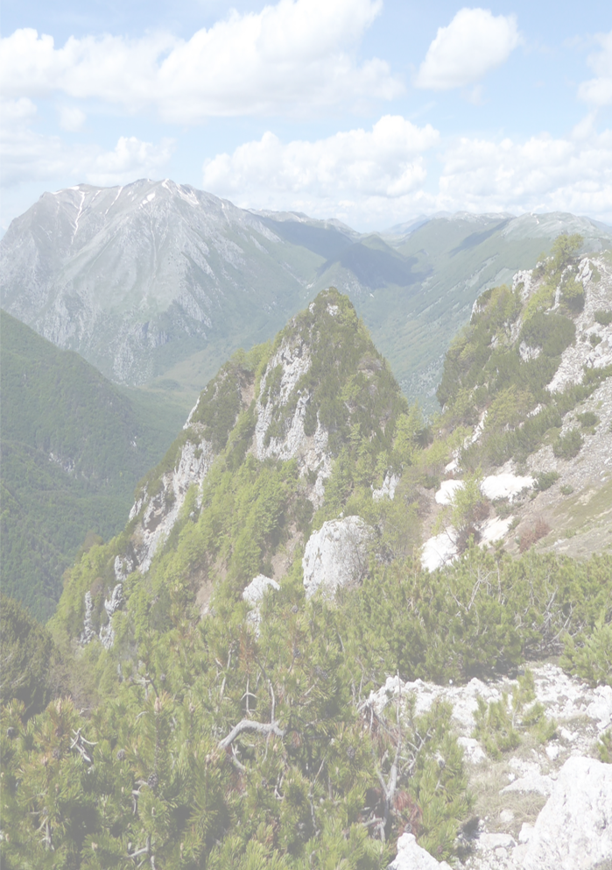
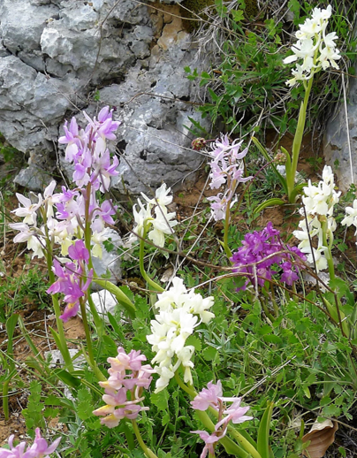
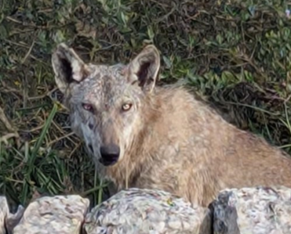
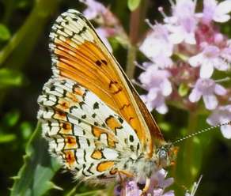
Some surprising wildlife of
Central Italy
an illustrated talk by Jessica Turner
Friday 27th November, 7pm for 7.30
St Andrew’s Church
Orchard Road, OX2 9BH
All welcome - free admission
Donations to WaterAid

